Slide 1

A Project Presentation on Airline Reservation System
GROUP : 15
(PG-DAC - SEPT 2022)
GUIDED BY : Mr . Zeeshan Ahmad Khan
NAME PRN
1) Chetan Nagmoti (220910120013 )
2) Bhavesh Gupta (220910120009 )
3) Mayuresh Kate (220910120029 )
4) Sudeep Suryavanshi (220910120049 )

Slide 2
Introduction:
The airline reservation system project aims to create a platform for passengers to book and manage their flights online. The system will provide a user-friendly interface for customers to search for flights, view schedules, and make reservations.
Overall, the airline reservation system project will streamline the booking process for customers and airlines, making it more efficient and convenient for all parties involved

Slide 3
Purpose:
An airline reservation system project is an essential tool for any airline company that seeks to enhance their customer experience, streamline their operations, and improve their overall efficiency.
By providing an online platform for customers to make reservations, purchase tickets, and select their preferred seating, the airline reservation system enables airlines to provide a convenient and user-friendly experience to their customers. This, in turn, can help attract more customers and increase revenue for the airline.

Slide 4
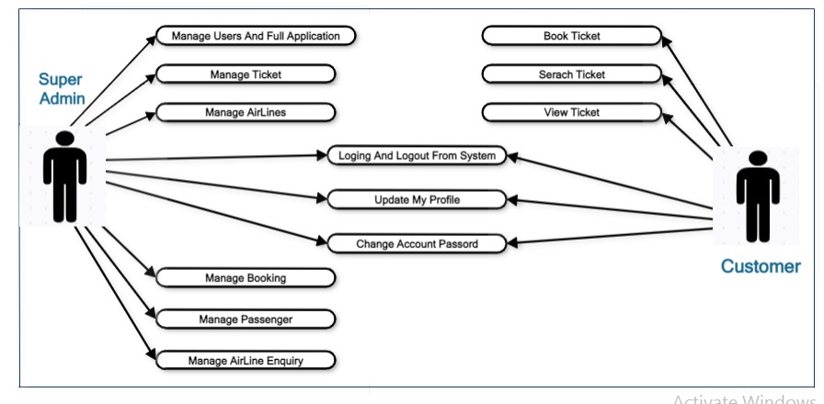
Use Case Diagram -

Slide 5
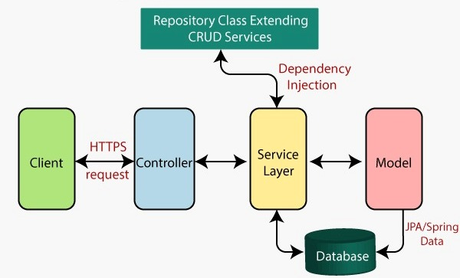
Architectural View -

Slide 6
Modules:
Customer Accounts
Login and Registration
Search Flight
Book Flight
Add passenger page
Booking Summary page
Booking History Page
Make Payment Page
Print ticket page

Slide 7
For Admin
Admin Home Page
Admin Login Page
Admin can add flights
Admin can update add flights
Available flight list page

Slide 8
Payment Module
Configurable to authorize and charge, or authorize only and on creation of invoices
Integrated with multiple Payment gateways
Saved Credit Card method form off-line payments
Accept Checks/Money Orders
Accept Purchase Orders

Slide 9
Technology
Front End:
Html - 5,Css - 3 ,Bootstrap - 5
React JS -17
Axios
Back End :
Spring boot,
Hibernate
Database :
MYSQL - 8
IDE:
Eclipse IDE - 2022

Slide 10
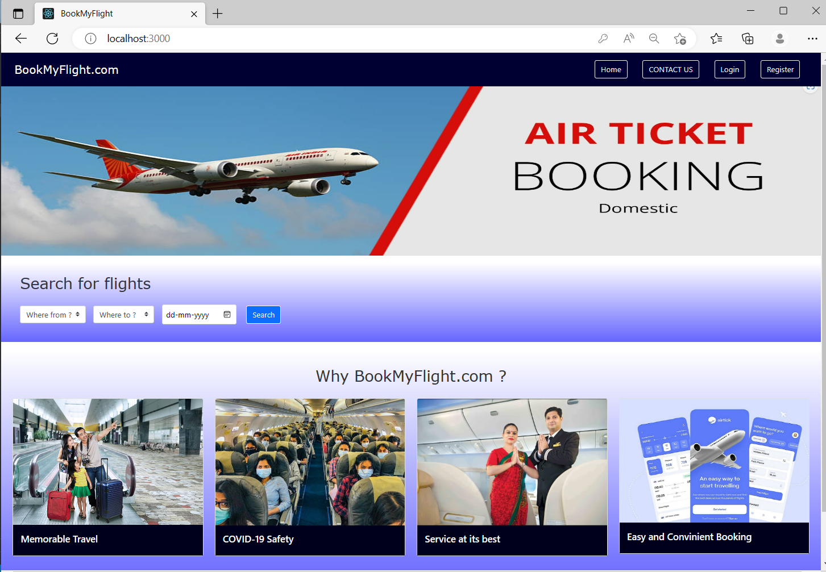
Home page :

Slide 11
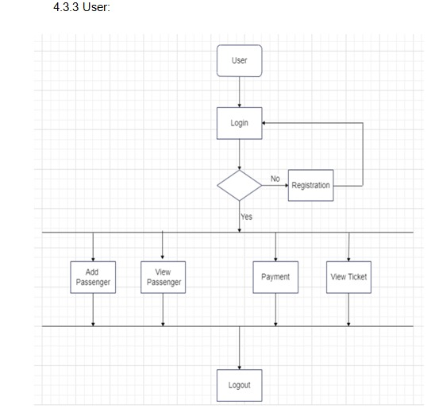
User Flow Chart

Slide 12
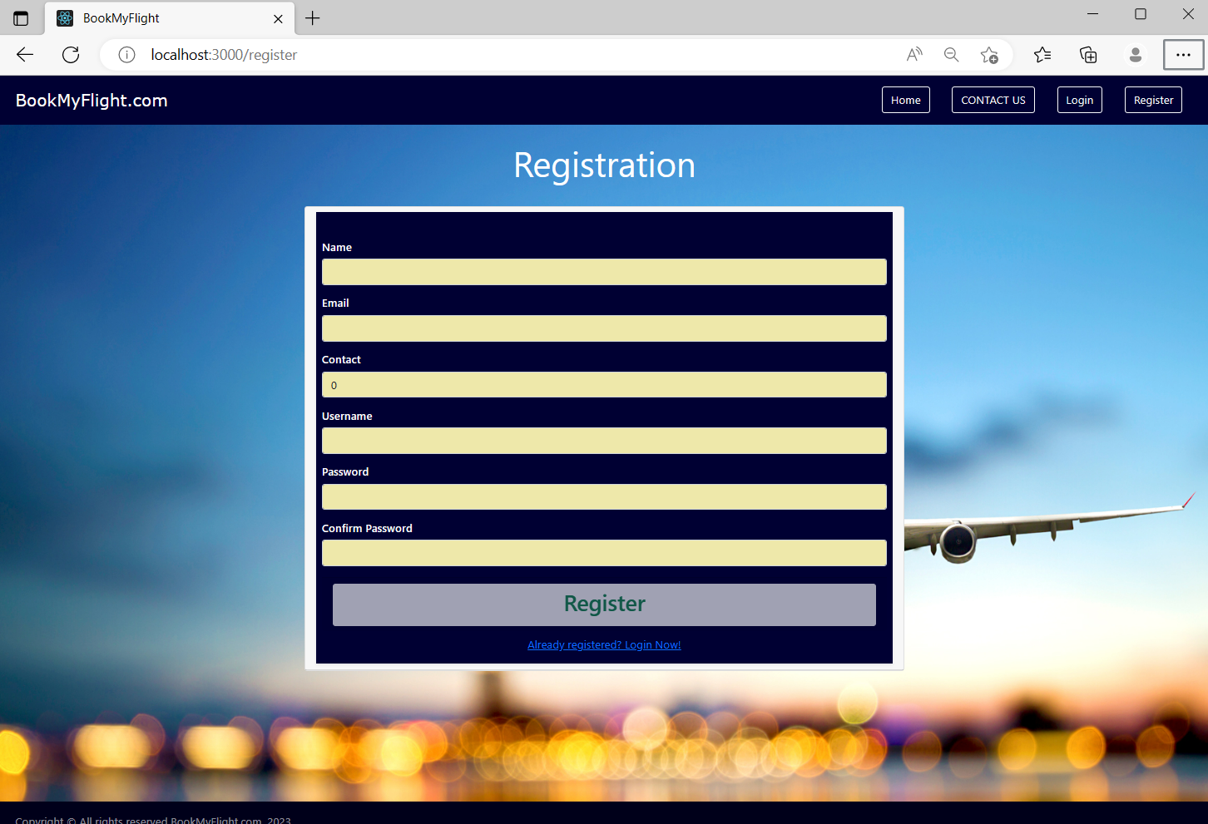
Register :

Slide 13
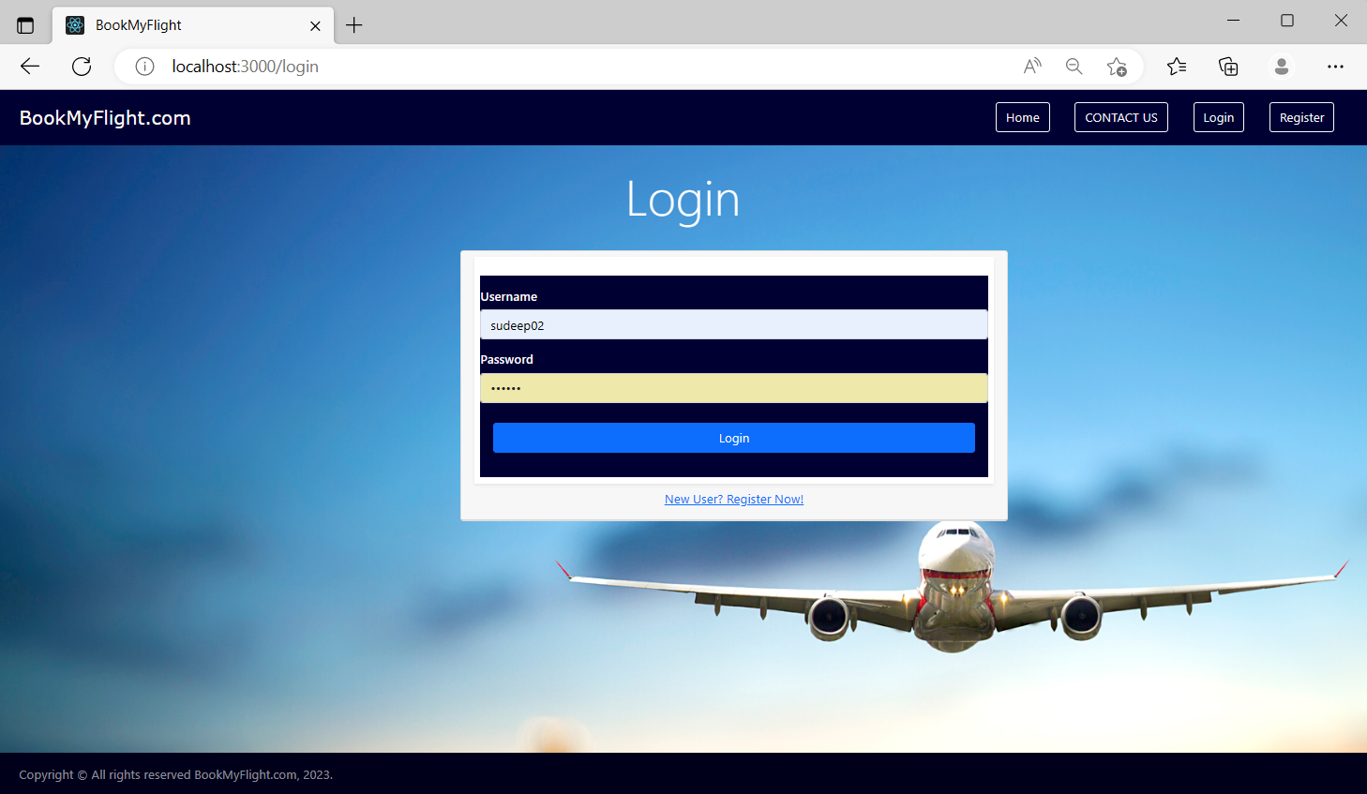
Login:

Slide 14
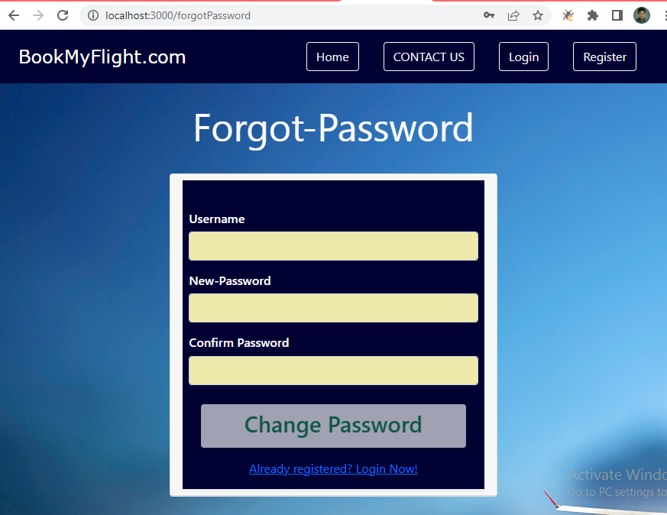
Forgot-Password

Slide 15
Login:

Slide 16
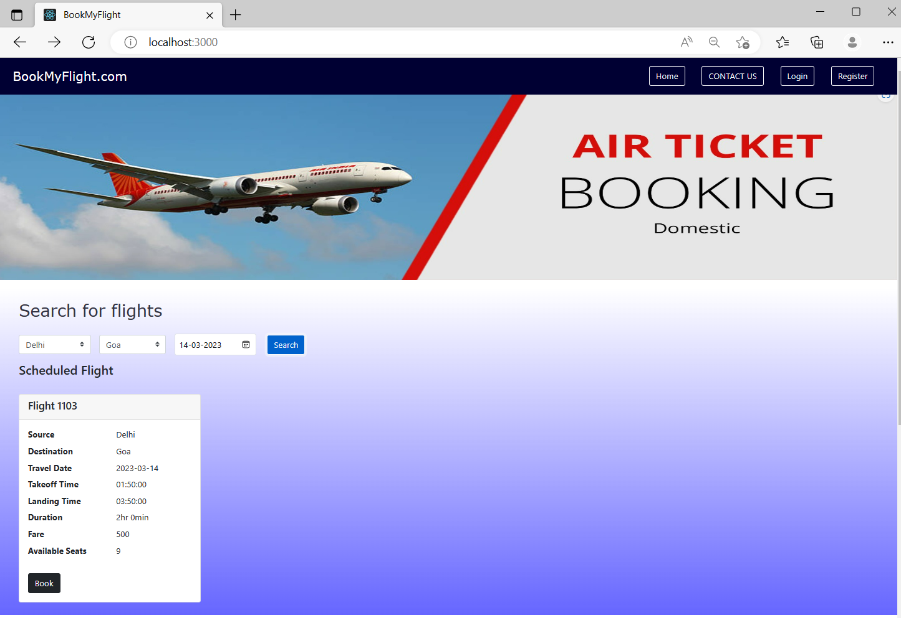
Search Flight:

Slide 17
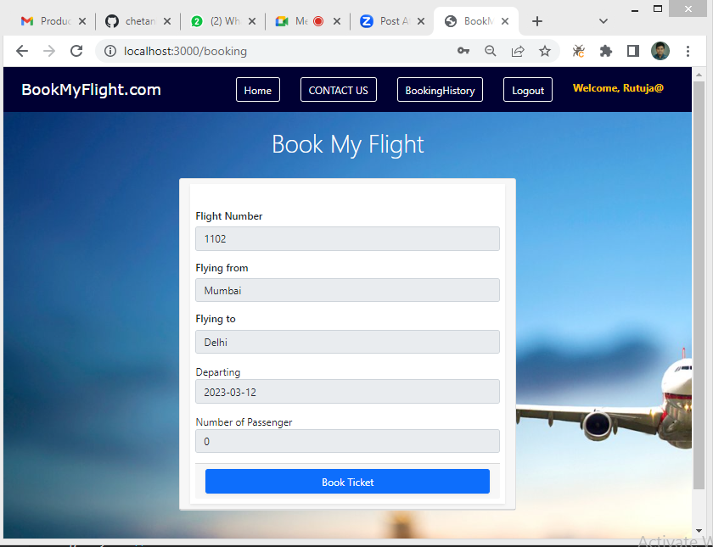
After Book

Slide 18
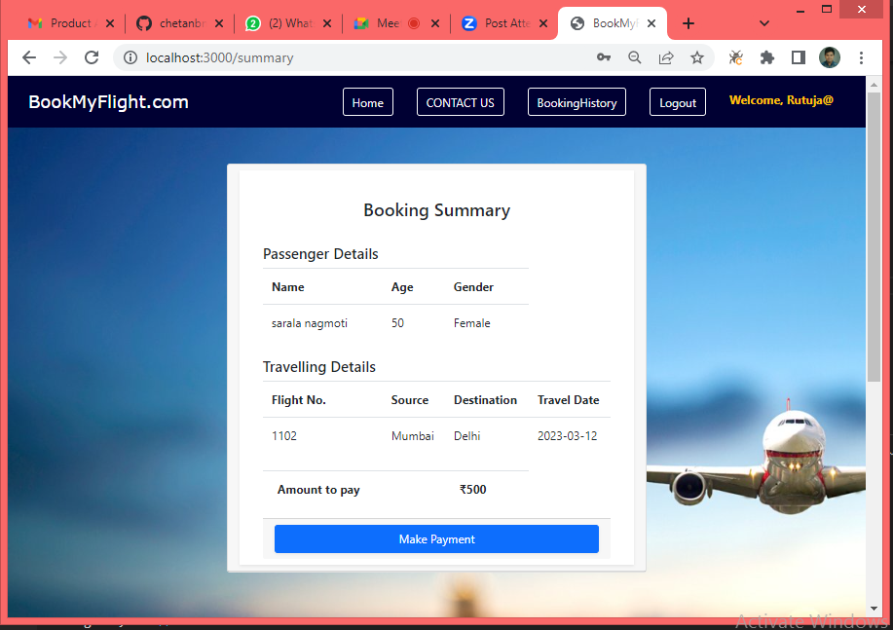
Booking Summary

Slide 19
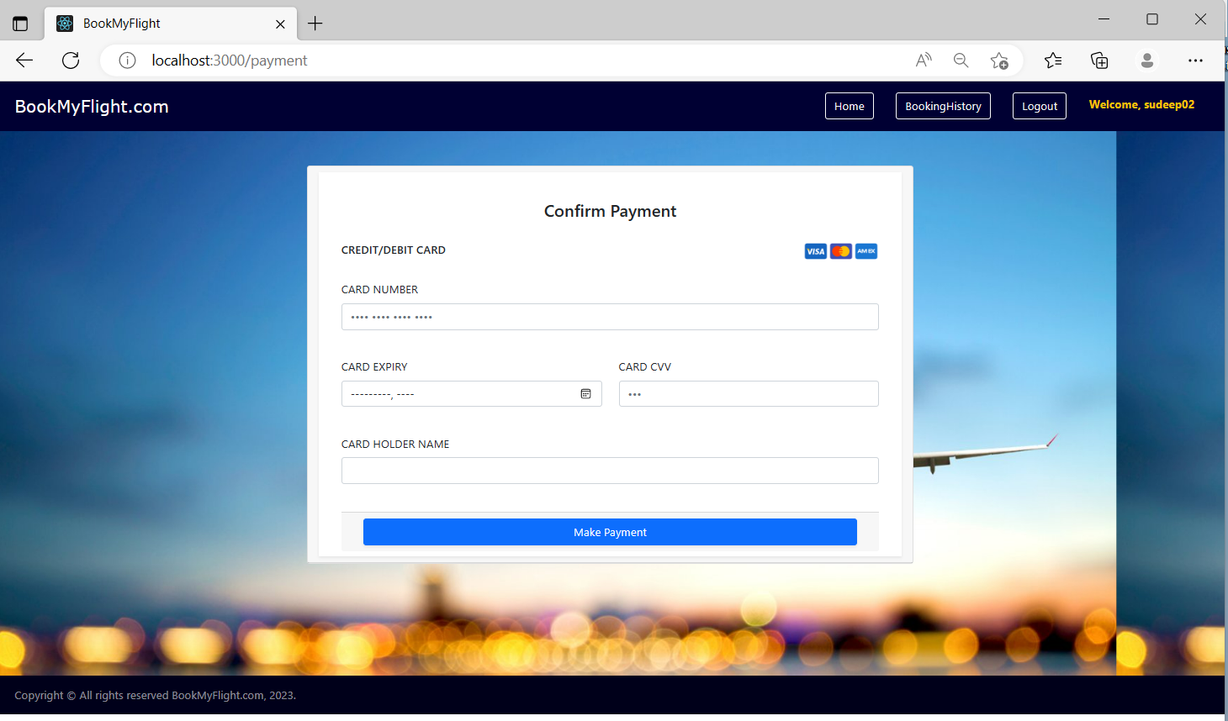
Payment :

Slide 20
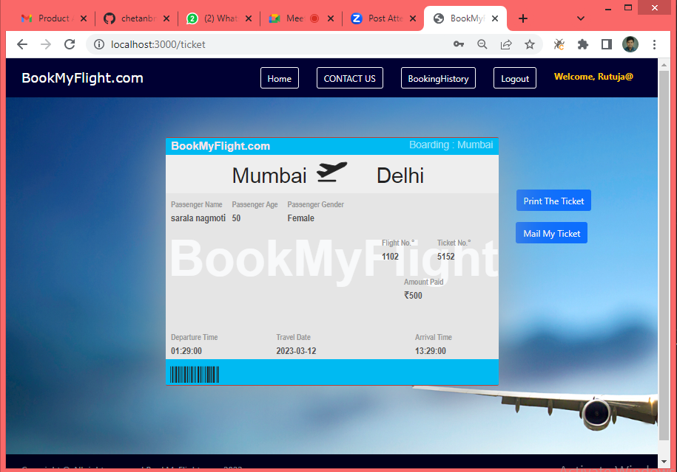
Ticket Generated

Slide 21
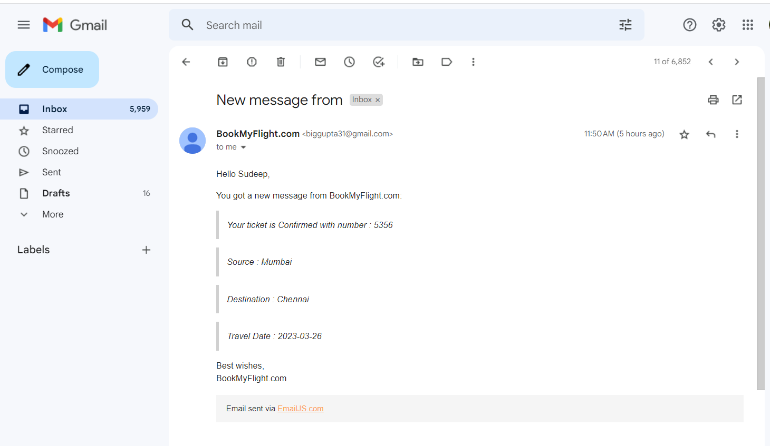
Successful Ticket Mail :

Slide 22
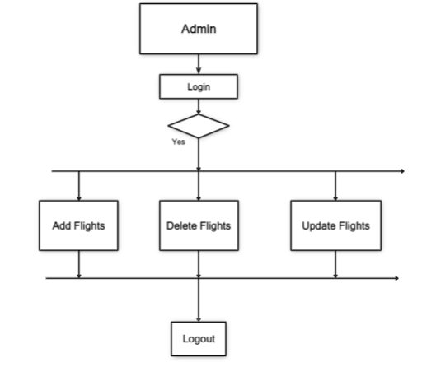
Admin Flow Chart

Slide 23
Admin - Home

Slide 24
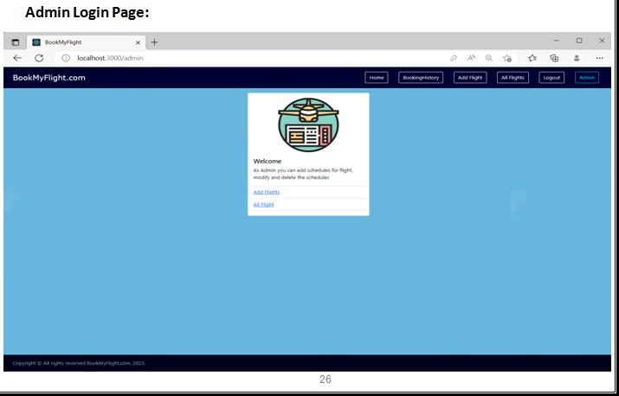

Slide 25
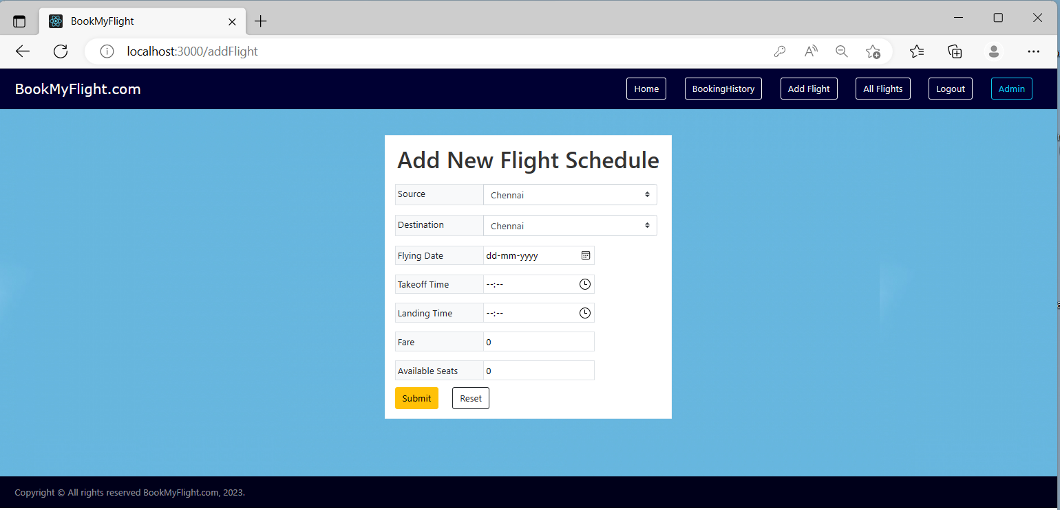
Add Flight:

Slide 26
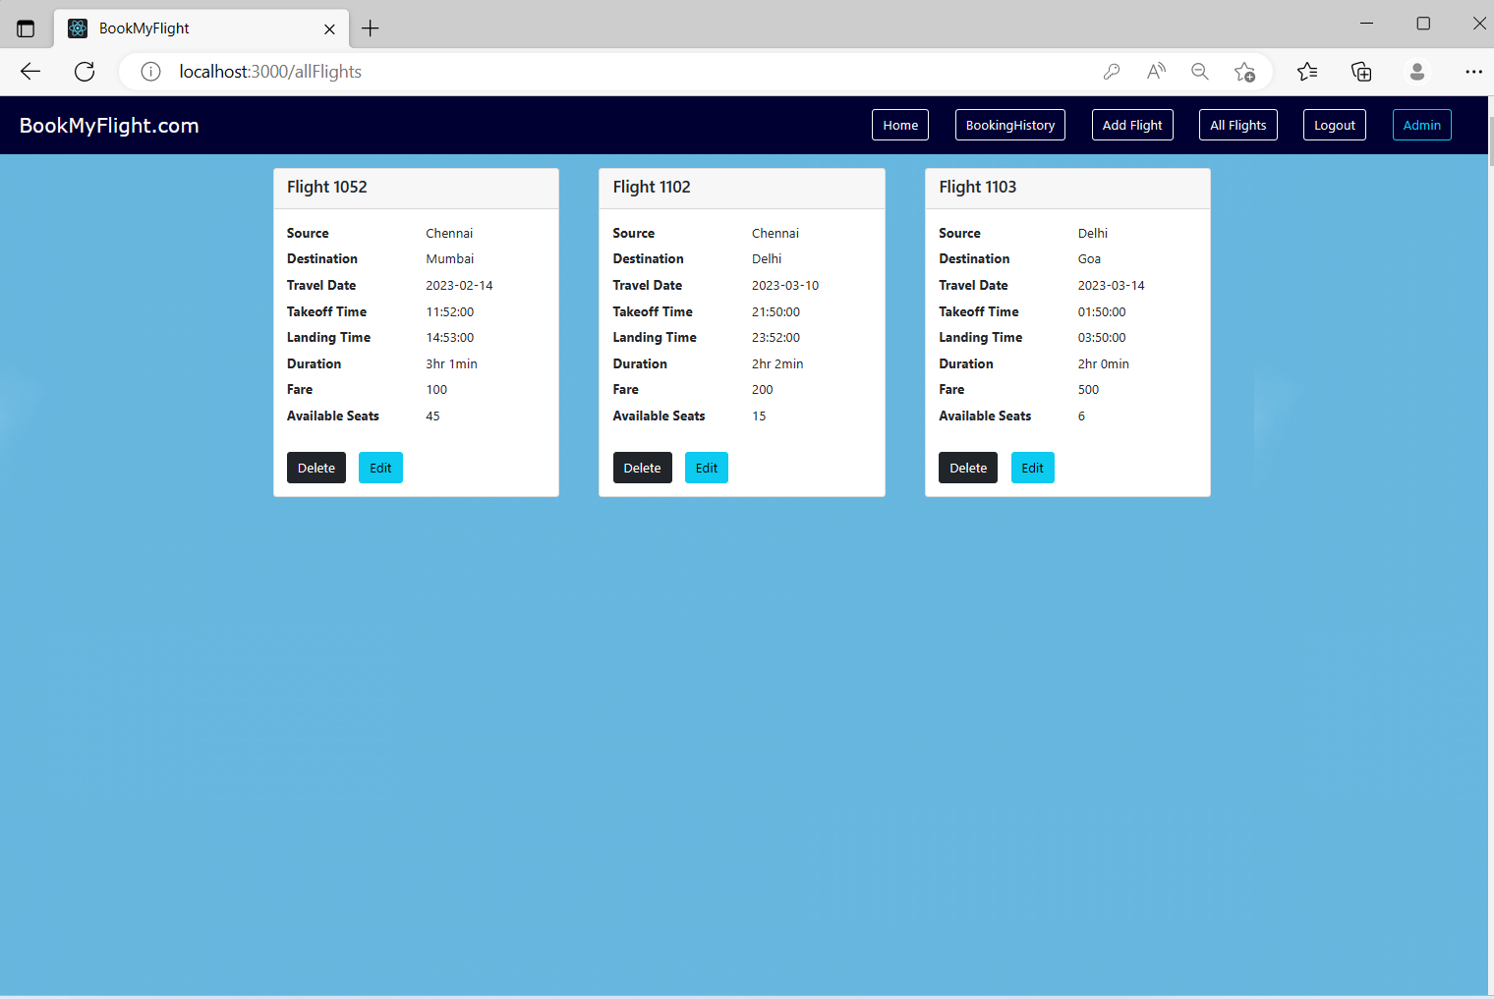
Display List of Flights :

Slide 27
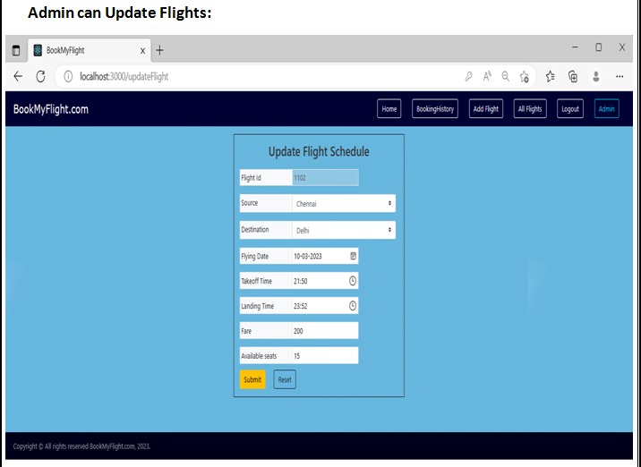

Slide 28
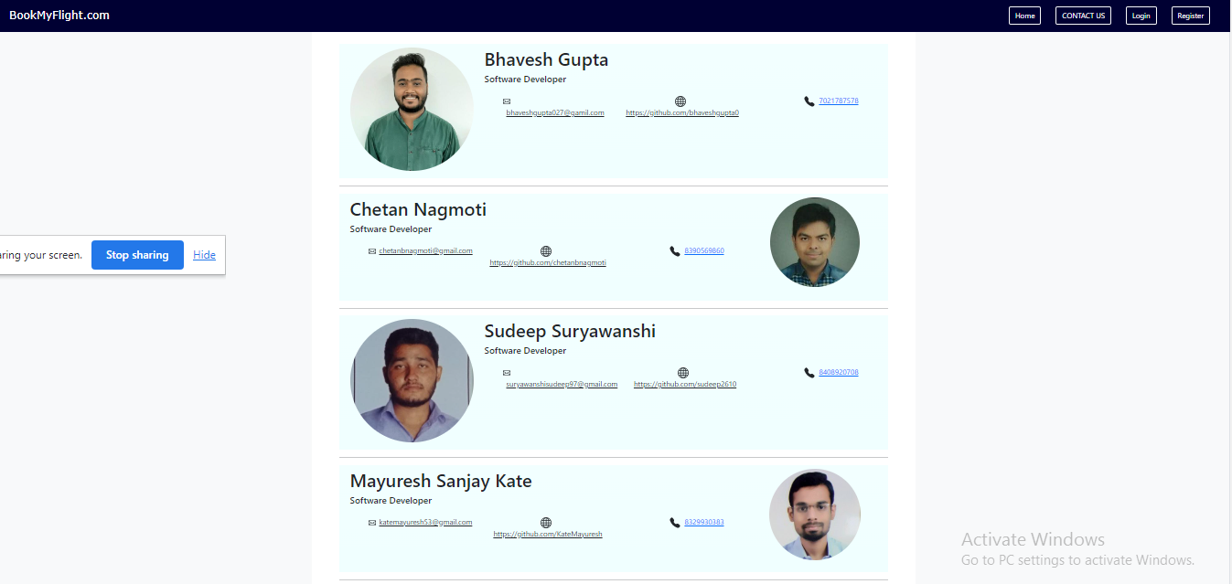
Contact-Us-Page

Slide 29
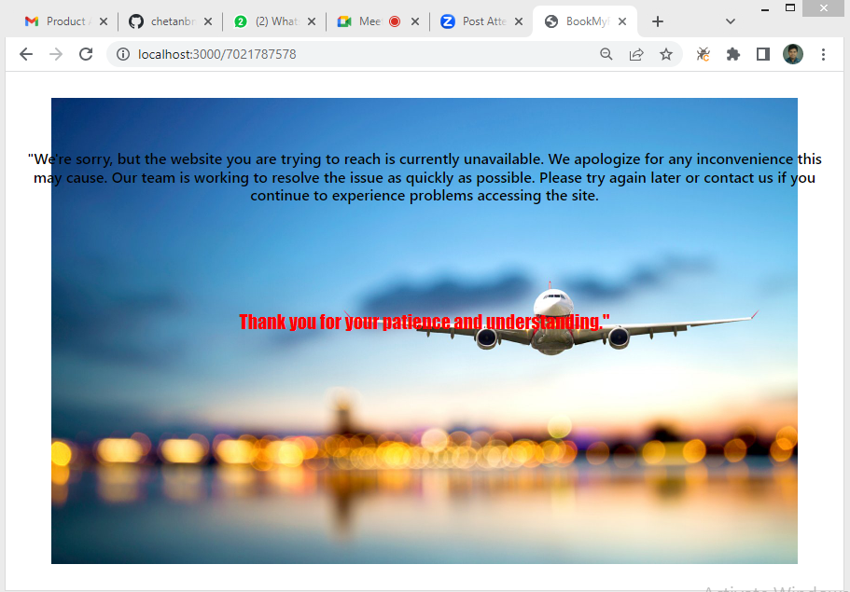
Error Page

Slide 30
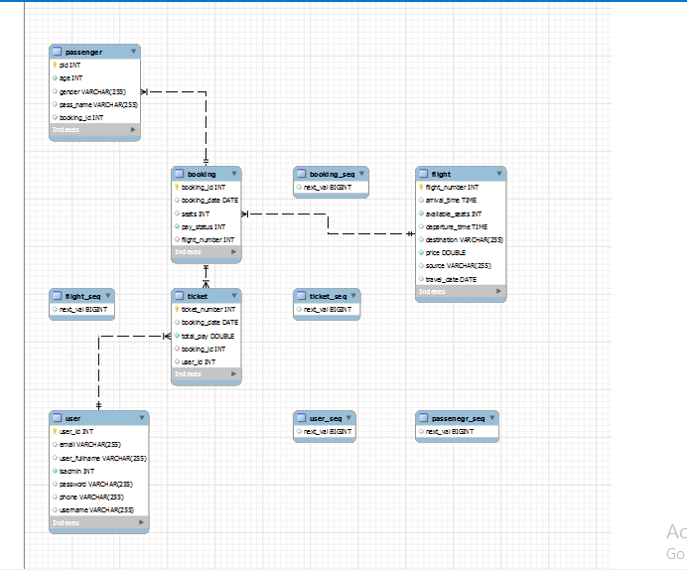
ER Diagram

Slide 31
Features
User Registration
Flight Search
Booking:.
Payment Gateway:
Reservation Confirmation

Slide 32
Conclusions
In conclusion, an airline reservation system is a crucial software application that allows customers to book and manage their flight tickets easily.

Slide 33
THANK YOU !!

